Slide 1
Multi-Relational Stacking Ensemble Recommender System Using Cinematic Experience
(Index Terms)
Graph Neural Network (GNN)
Recommender system
Sentiment analysis
Emotion analysis
BERT
Presenter : Cheonsol Lee
Date : 2021.10.28
Notes:
안녕하세요.
BERT의 감성분석을 활용한 그래프 기반의 영화 추천시스템에 대한 연구를 말씀드리겠습니다.

Slide 2
1
Introduction
2
Related Work
3
Method
INDEX
4
Experiment
5
Results
6
Conclusion

Slide 3
1. Introduction
Thank you

Slide 4


1. Introduction – Motivation
Industry of Recommender System
User experience(UX) is required for personalized marketing.
When watching the movies, UX may be expressed as Sentiment/Emotion data.
Cinematic Experience (CX) [1]
It means an unforgettable experience from watching a film.
User’s psychological information -> Sentiment/Emotion
Rational basis [2]
User’s feelings are reflected in the movie review.
There is a correlation between emotions about the movie reviews and satisfaction.
Emotional information can be used as personalized data.
[1] Cinematic experience, film space, and the child’s world (Canadian Journal of Film Studies 2010)
[2] The impact of emotions on the helpfulness of movie reviews (JART 2015)

Slide 5
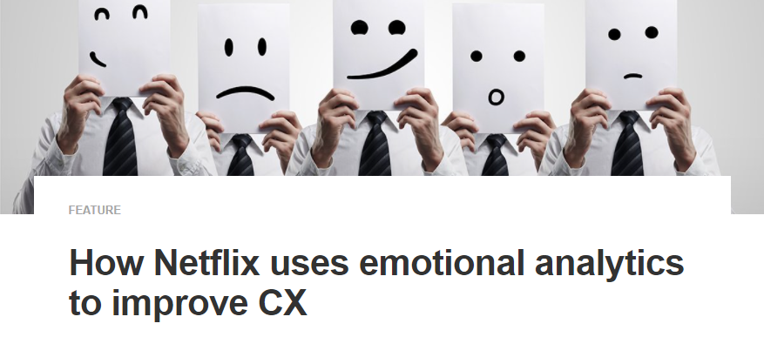

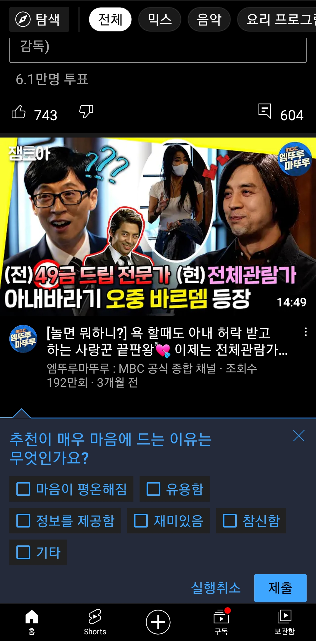
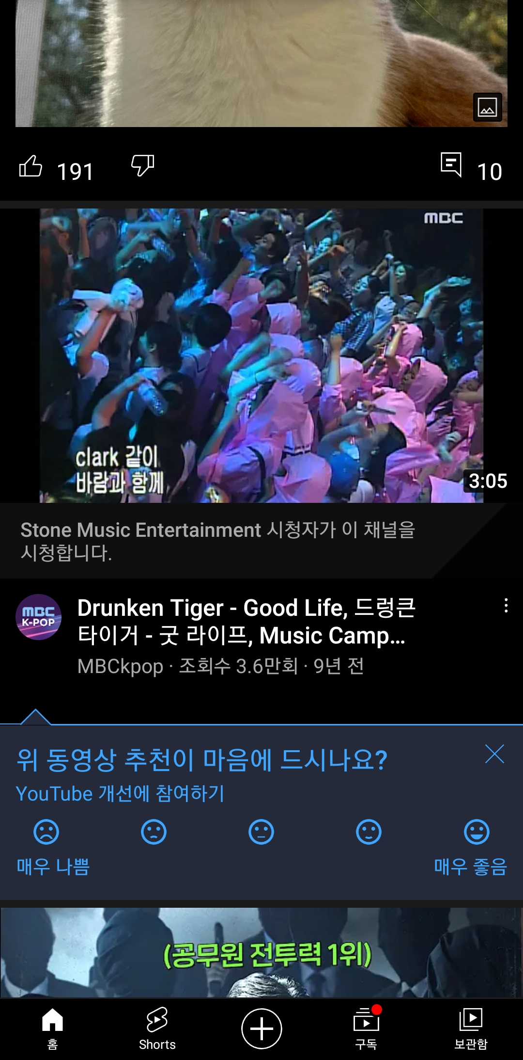

1. Introduction – Industrial Cases
Industrial Cases of Sentiment/Emotion for Personalized Recommendation
Netflix
Emotional analytics to improve CX
Emotional analytics enable businesses to obtain customer feedback.
YouTube
Report : Sentiment(5-levels), Emotion(part level)
<Technical report>
<Sentiment>
<Emotion>

Slide 6
1. Introduction – Research Question(RQ)
RQ1) Is it possible to improve performance by embedding an ordinal feature and
a categorical feature together in GCN?
RQ2) Which model performs the best rating prediction in recommender system algorithms?
RQ3) Is there a significant difference when sentiment and emotion are reflected in the model?
RQ4) Which embedding framework performs the best?

Slide 7
2. Related Work
Thank you

Slide 8
2. Background
Definition
Sentiment divides user’s positive and negative feelings into 5-levels. (Type: ordinal)
Emotion divides user’s psychological feelings into 6-levels. (Type: categorical)
0 | 1 | 2 | 3 | 4
Negative | Somewhat Negative | Neutral | Somewhat Positive | Positive
0 | 1 | 2 | 3 | 4 | 5
anger | fear | joy | love | sadness | surprise

Slide 9
2. Related Work (cont’d)
Emotion Analysis
[1] The impact of emotions on the helpfulness of movie reviews (JART 2015)
[2] Tensor-based tag emotion aware recommendation with probabilistic ranking. (KSII 2019)
[3] Item recommendation using tag emotion in social cataloging services. (ScienceDirect 2017)
[4] Using Affective Features from Media Content Metadata for Better Movie Recommendations (KDIR 2020)
Detect movie overviews’ implicit affective features like emotion and sentiment.
Strength: reflect dynamic information like user’s emotion and sentiment
Sentiment Analysis
[5] Review Sentiment-Guided Scalable Deep Recommender System (SIGIR 2018)
[6] How to improve the accuracy of recommendation systems: Combining ratings and review texts sentiment scores. (JIIS 2019)
[7] The impact of emotions on the helpfulness of movie reviews (JART 2015)
There is a correlation between emotions about the movie reviews and satisfaction.
[8] Integrating Collaborative Filtering and Sentiment Analysis : A Rating Inference Approach (ECAI workshop 2006)
Approach sentiment analysis with statistical techniques
[9] BERT 기반 감성분석을 이용한 추천시스템 (KCI 2021)
Comparing Emotional Analysis with ML/DL Techniques and Presenting the Performance of BERT
Limitation : rating inference was only carried out, and explainable recommendation is not possible.
[10] Movie Recommendation System Using Sentiment Analysis From Microblogging Data (IEEE transactions on computational social systems 2020)
Hybrid RS from collaborative filtering(CF) and content-based filtering(CBF) along with sentiment analysis

Slide 10
2. Related Work
Graph Neural Network
[10] Semi-Supervised Classification with Graph Convolutional Networks (ICLR 2017)
GCMC-based
[11] Graph Convolutional Matrix Completion (KDD 2018)
[12] Inductive Matrix Completion based on Graph Neural Networks (ICLR 2020)
[13] Inductive Matrix Completion Using Graph Autoencoder (CIKM 2021)
[14] AIRC: Attentive Implicit Relation Recommendation Incorporating Content Information for Bipartite Graphs (MDPI 2020)
Multi-layer graphs
[15] Community Detection in Multi-Layer Graphs: A Survey (SIGMOD 2015)
Link-prediction and GCN
[16] Link Prediction Based on Graph Neural Networks (NIPS 2018)
[17] Web Service Network Embedding based on Link Prediction and Convolutional Learning (IEEE Transactions on Services Computing)
Bi-partite graph
[18] Bipartite graph partitioning and data clustering (CIKM 2001)
[19] Metadata-Based Collaborative Filtering Using K-Partite Graph for Movie Recommendation (EDB 2012)
[20] Domain Knowledge-Based Link Prediction in Customer-Product Bipartite Graph for Product Recommendation (IJIT & DM 2019)

Slide 11
3. Method
Thank you

Slide 12
3. Method
Web Crawling
Movie Database
Sampling
Review
Rating
Review
BERT
BERT
Normalization
Sentiment / Emotion
Sentiment
Emotion
Multi-relations graph
generating
Graph Model
Rating Prediction
Figure 1. Overview of the proposed framework

Slide 13
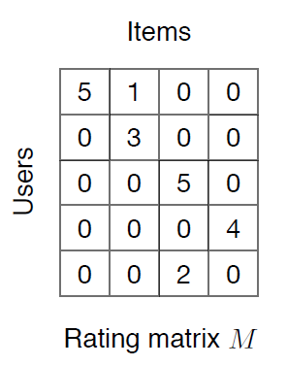
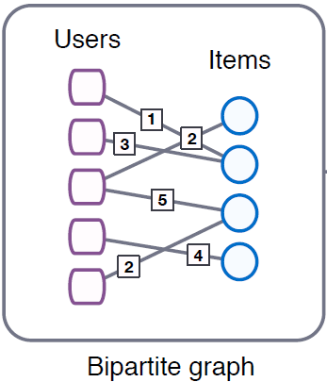
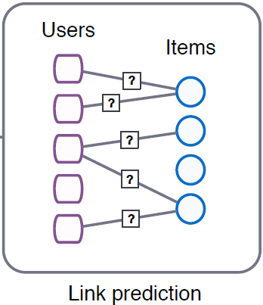
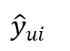
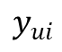
3. Framework – Baseline
User features: top_critic, publisher_name
Item features: title, year, genres
Target
$$y_{ui}$$
User embedding
GCMC
Encoder
GCMC
Decoder
$${\hat{y}}_{ui}$$
Prediction
Item embedding
Reference: [11] Graph Convolutional Matrix Completion (KDD 2018)
Notes:
그래프를 단순 합으로 결합
Multi-layer로 구성하여 GNN 학습

Slide 14
3. Framework – Baseline + IDEA concept
Target
$$y_{ui}$$
M | R | U
0 | 3 | 1
1 | 2 | 1
2 | 1 | 2
User embedding
GCMC
Encoder
GCMC
Decoder
$${\hat{y}}_{ui}$$
Prediction
Item embedding
(Rating)
Type1
Type2
Type3
Notes:
그래프를 단순 합으로 결합
Multi-layer로 구성하여 GNN 학습

Slide 15
3. Framework1 – Before Encoding
M | R | U
0 | 3.5 | 1
1 | 4.7 | 1
2 | 1.3 | 2
Target
$$y_{ui}$$
(Rating)
M | R | U
0 | 3 | 1
1 | 2 | 1
2 | 1 | 2
User embedding
GCMC
Encoder
GCMC
Decoder
$${\hat{y}}_{ui}$$
Prediction
Item embedding
(Sentiment)
M | R | U
0 | 5 | 1
1 | 2 | 1
2 | 3 | 2
(Emotion)
Notes:
그래프를 단순 합으로 결합
Multi-layer로 구성하여 GNN 학습

Slide 16
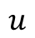
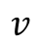
3. Framework1 – Before Encoding
rating
2
3
3
sentiment
emotion
3
rating
12
sentiment
item
emotion
 |  | 0
 |  | 1
 |  | 0
17
user
Figure 2: multi-relational graph
rating 2
rating 3
rating 4
Figure 3: Graphs and adjacent matrices
for user 2 and movie 3 about rating edge
Notes:
그래프를 단순 합으로 결합
Multi-layer로 구성하여 GNN 학습

Slide 17
3. Framework1 – Before Encoding
3
rating
rating (0-9)
1
12
1
sentiment
sentiment (10 - 14)
emotion
17
emotion (15 - 20)
2
0 | 1 | 1 | 0 | 1
0 | 0 | 0 | 1 | 0
1 | 0 | 0 | 1 | 0
1 | 1 | 1 | 0 | 1
1 | 0 | 0 | 1 | 0
2
18
3
1
3
4
4
11
Figure 5: Transforming multi-relational graphs to adjacent matrices
Notes:
그래프를 단순 합으로 결합
Multi-layer로 구성하여 GNN 학습

Slide 18
4. Experiment
Thank you

Slide 19
4. Experiment – dataset (Movie)
Dataset
Period : 1914.06.01 ~ 2020.10.31
Link : https://www.kaggle.com/stefanoleone992/rotten-tomatoes-movies-and-critic-reviews-dataset
Data
File name | Dimension | Columns
Movie data | (17713, 22) | 'rotten_tomatoes_link', 'movie_title', 'movie_info', 'critics_consensus', 'content_rating', 'genres', 'directors', 'authors', 'actors', 'original_release_date', 'streaming_release_date', 'runtime', 'production_company', 'tomatometer_status', 'tomatometer_rating', 'tomatometer_count', 'audience_status', 'audience_rating', 'audience_count', 'tomatometer_top_critics_count', 'tomatometer_fresh_critics_count', 'tomatometer_rotten_critics_count'
Review data | (1048576, 8) | rotten_tomatoes_link, critic_name, top_critic, publisher_name, review_type, review_score, review_date, review_content
Rating | Review | Amount | Rate
O | O | 758,709 | 67%
X | O | 305,502 | 27%
O | X | 65,372 | 5%
X | X | 434 | 0.03%

Slide 20
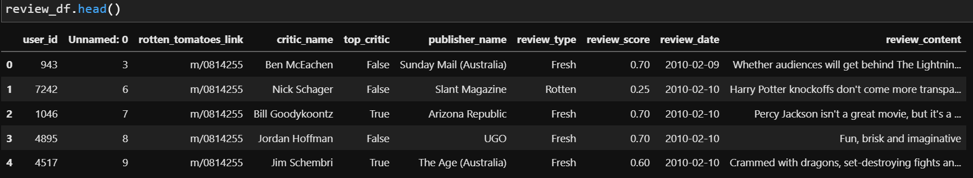
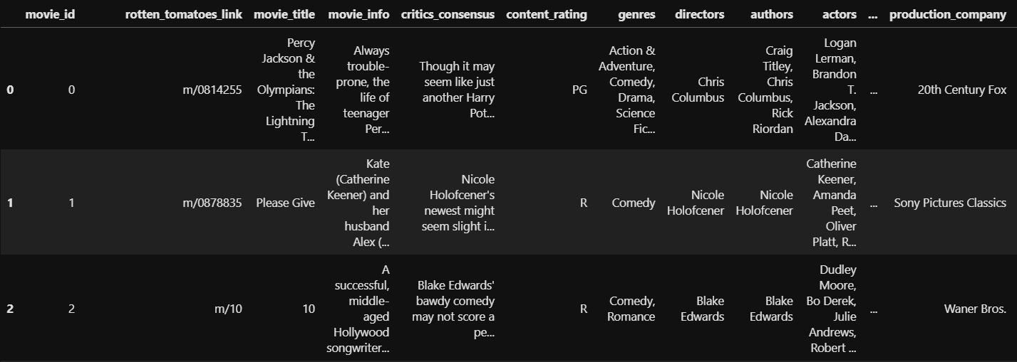
4. Experiment – dataset (Movie)
Dataset
Rating matrix
Group : critic_name, top_critic, publisher_name
The number of users : 9,794
Movie matrix
The number of movies: 17,614

Slide 21
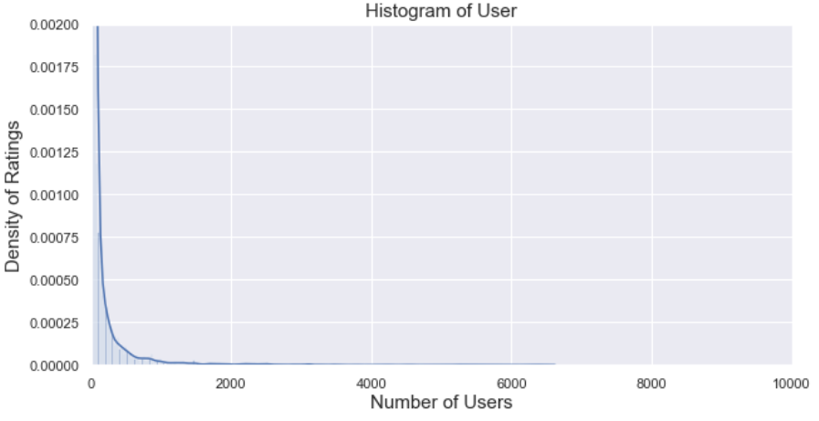
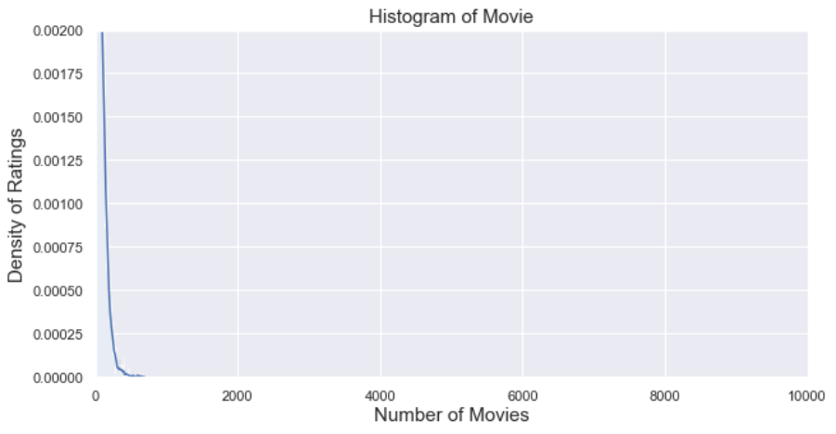
4. Experiment – dataset (movie)
Long-tail graphs
Group: User, Movie
Train/test rate = 9 : 1 (by timestamp)
Number: user_id(850), movie_id(6,805)
Exclude cold-start problem (user, item)
Range | User | Movie
Total | 9,794 | 17,614
< 3 | 3,552 (36%) | 993 (6%)
< 5 | 4,653 (48%) | 2,892 (16%)
>= 20 | 2,994 (31%) | 8,110 (46%)
>= 500 | 345 (4%) | 13 (0%)
Reviews >= 20
<User>
<Movie>

Slide 22
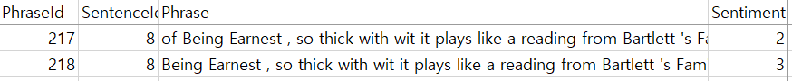
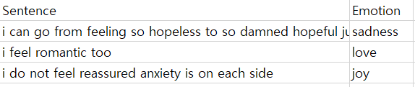
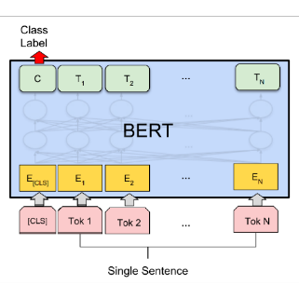
4. Experiment – dataset (sentiment, emotion)
Sentiment, Emotion dataset
Training data for BERT model in Kaggle
Sentiment[1]
Emotion[2]
Feature generating/augmentation using BERT fine-tuning
0 | 1 | 2 | 3 | 4
Negative | Somewhat Negative | Neutral | Somewhat Positive | Positive
0 | 1 | 2 | 3 | 4 | 5
anger | fear | joy | love | sadness | surprise
Review data
Result
U | E | M
0 | 1 | 1
1 | 3 | 1
2 | 2 | 2
Uma Thurman as Medusa, the gorgon with a coiffure of writhing snakes and stone-inducing hypnotic gaze is one of the highlights of this bewitching fantasy
Sentiment, emotion value
(graph)
[1] Sentiment Analysis on Movie Reviews
[2] Emotion dataset for NLP

Slide 23
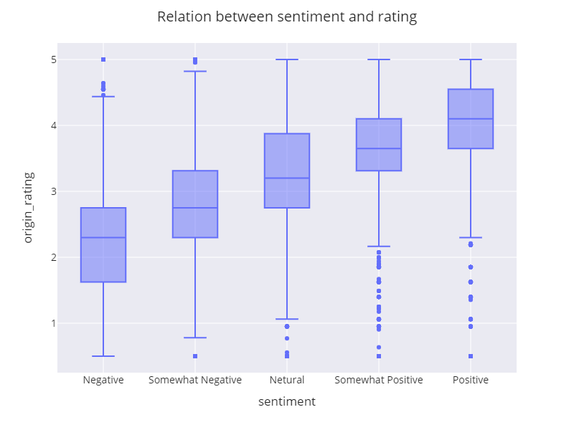
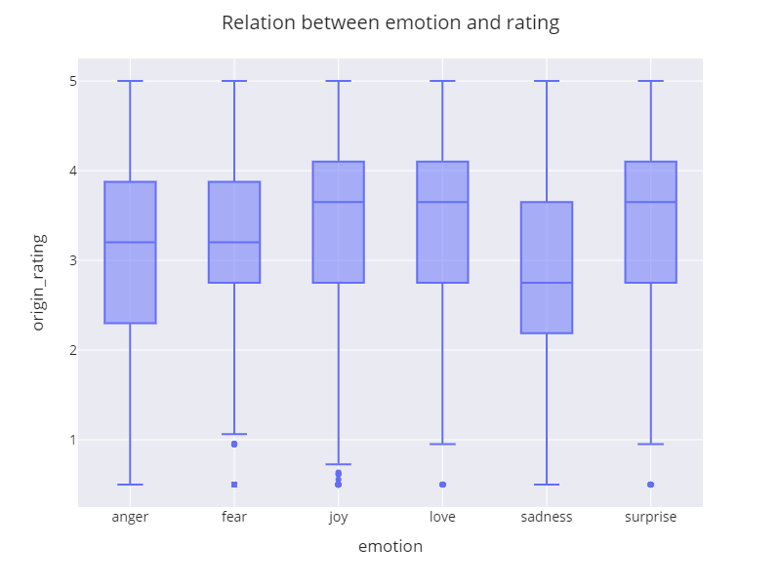
4. Experiment – dataset (sentiment, emotion)
Relation between rating and sentiment/emotion
Figure 7: Relation between sentiment and rating
Figure 8: Relation between emotion and rating

Slide 24
4. Experiment – Grid search
Grid search
Conventional models
Models : KNNWithMeans, SVD, and SVDpp (Surprise library)
Hyperparameter
KNNWithMeans : k(10,15, 25), name(Pearson_baseline, Cosine)
SVD, SVDpp : learning_rate(0.005, 0.006, 0.007)
GCMC based modes
Hyperparameter
Dimensions : 75, 150, 225
Drop out : 0.3, 0.5, 0.7
Learning rate : 0.005, 0.01, 0.02, 0.03

Slide 25
5. Results
Thank you

Slide 26
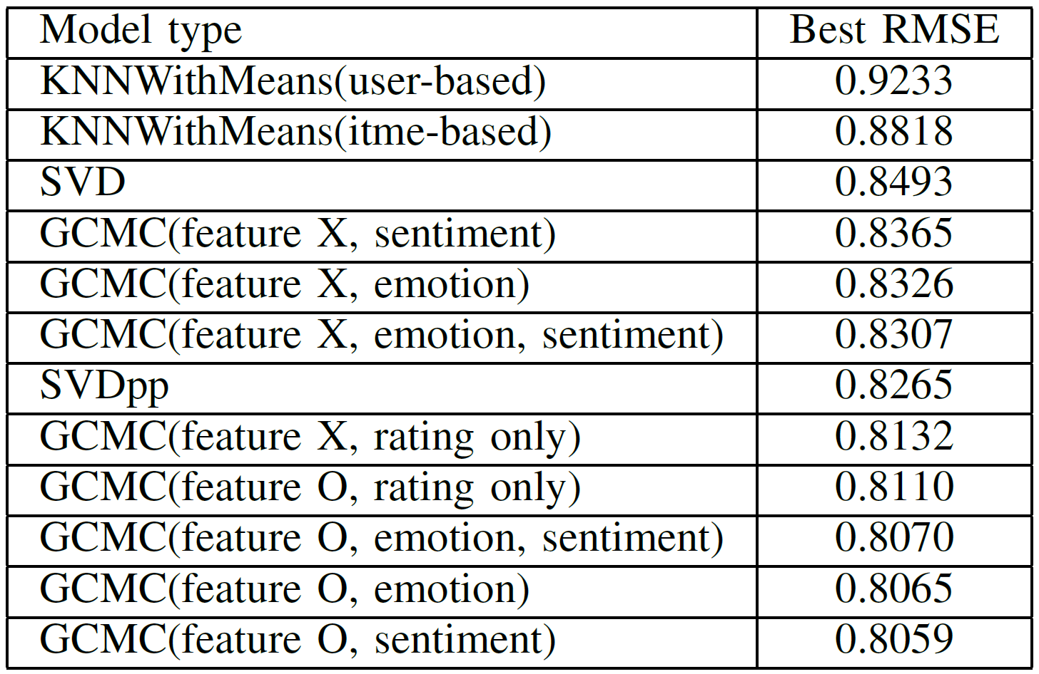
5. Results – Table
Table 1: RMSE results

Slide 27
Figure 10. RMSE graph comparing model type

Slide 28
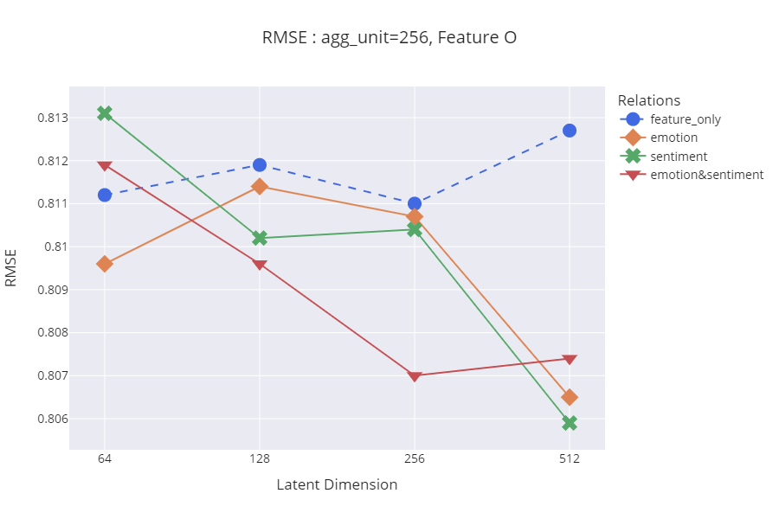
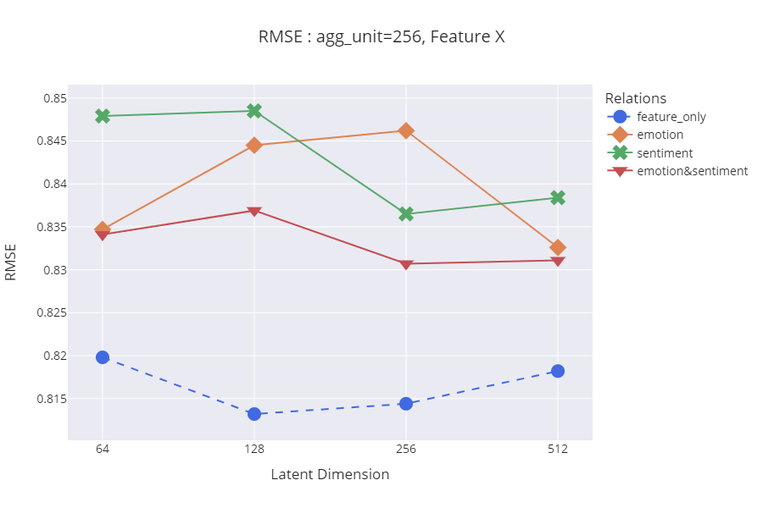
5. Results – RMSE Graph
Figure 9. RMSE graph comparing dimensions with node features

Slide 29
6. Conclusion
Thank you

Slide 30
6. Conclusion
Natural language information can be used in a graph-based recommender system through a method of stacking GCMC and BERT.
Using both ordinal data like sentiment and categorical data like emotion can also improve the performance of the model.
GNN-based recommendation is better than traditional methods because the graph reflects the multi-relational information between users and items.
Multi-relational graphs can be reflected in the GCMC in the manner we propose, and multi-relations can be replaced by other meta-information between users and items.
This concept can be expanded in many domains like shopping, social network with other algorithms.

Slide 31
To do
Thank you

Slide 32
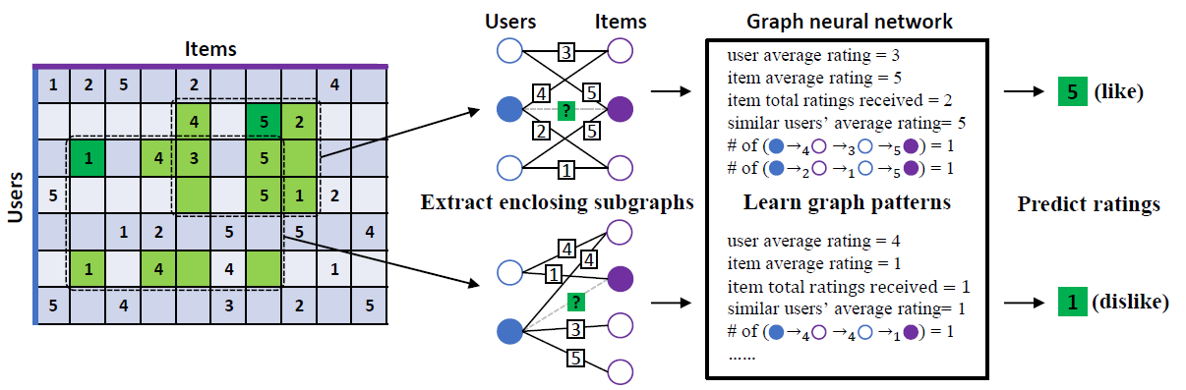
IGMC (Inductive Graph-based Matrix Completion)
IGMC (ICLR 2020)
The model that improved the shortcomings of GCMC
It is the state-of-the-art model among rating inference models using bipartite graphs.
Characteristics
Inductive for generalization
No side-information needed
Efficient because it learns in units of sub-graphs, not in units of total-graphs
Future work: side-information based recommendation
Sub-graph
Notes:
그래프를 단순 합으로 결합
Multi-layer로 구성하여 GNN 학습

Slide 33
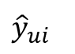
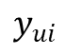
Framework1: Aggregated embedding
Subgraph
Embedding
Users
Rating
Items
3
Rating
4
5
?
Target
2
5
1
$$y_{ui}$$
New
Embedding
Users
Sentiment
Items
3
4
5
MLP
Sentiment
?
$${\hat{y}}_{ui}$$
2
5
Prediction
1
Users
Emotion
Items
3
[Aggregation Functions]
Mean
Sum
Avg
Concat
Emotion
4
5
?
2
5
1
Notes:
그래프를 단순 합으로 결합
Multi-layer로 구성하여 GNN 학습

Slide 34
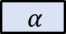
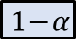
Framework2: CX ratio-based embedding
Subgraph
Embedding
Users
Rating
Items
3
Rating
4
5
?
2
5
Target
1
$$y_{ui}$$
New
Embedding
Users
Sentiment
Items
3
4
5
MLP
Sentiment
?
$$α$$
$${\hat{y}}_{ui}$$
2
5
Prediction
1
Users
Emotion
Items
3
[Aggregation Functions]
Mean
Sum
Avg
Concat
Emotion
4
5
?
$$1−α$$
2
5
1
Notes:
그래프를 단순 합으로 결합
Multi-layer로 구성하여 GNN 학습

Slide 35
Framework3: Attention-based embedding
Subgraph
Embedding
Users
Rating
Items
3
Rating
4
5
?
Attention
2
5
Target
1
$$y_{ui}$$
New
Embedding
Users
Sentiment
Items
3
4
5
MLP
Sentiment
?
Attention
$${\hat{y}}_{ui}$$
2
5
Prediction
1
Users
Emotion
Items
3
[Aggregation Functions]
Mean
Sum
Avg
Concat
Emotion
4
5
?
Attention
2
5
1
Notes:
그래프를 단순 합으로 결합
Multi-layer로 구성하여 GNN 학습

Slide 36


Case Study: Multi-emotion vs Simple-emotion
Movies that reflect various emotions
Purpose: Identify the evaluation tendency of the model according to emotions.
Users feel various emotions about a particular movie.
Comparison of rating tendency between multi-emotion based movies and simple-emotion based movies
Analysis of information that is not reflected in the rating
Expected: joy, love
Expected: joy, love, anger, fear, sadness, surprise
<The distribution chart of emotions on the movies>
<Tentative comparison lists>
Notes:
그래프를 단순 합으로 결합
Multi-layer로 구성하여 GNN 학습

Slide 37
Thank you
Thank you

Slide 38
Feedback
Thank you

Slide 39
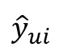
Framework4: Knowledge Distillation
Subgraph
Embedding
New
Embedding
Users
Rating
Items
3
Prediction
MLP
Rating
4
5
$${\hat{y}}_{ui}$$
?
2
5
A
1
Users
Sentiment
Items
3
$$y_{ui}$$
Sentiment
4
5
Target
?
2
5
B
1
Users
Emotion
Items
3
Train Loss : |A-B| + |A-C| + |Prediction-Target|
Testset : only rating dataset (Cover: rating O, review X)
Emotion
4
5
?
2
5
C
1
Notes:
그래프를 단순 합으로 결합
Multi-layer로 구성하여 GNN 학습

Slide 40
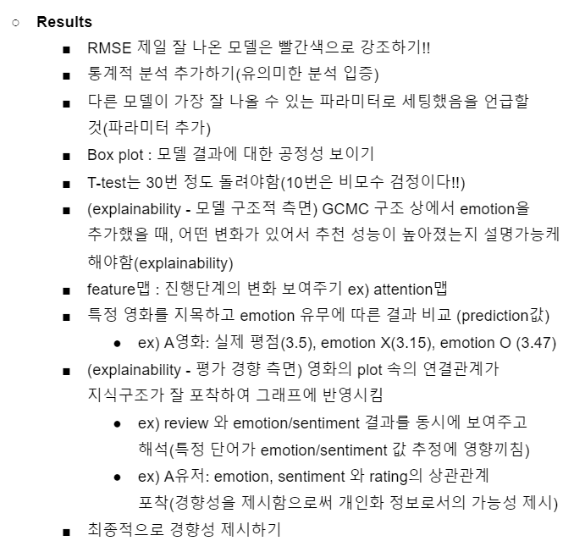
Feedback (이문용 교수님)

